Slide 1

Barcode data question answering models for the visually impaired
Presented by:
Ramesh Kumar Bacchu
Tanishq Motupalli
Abhinav Varma Lakamraju

Slide 2

OUTLINE OF PRESENTSTION
INTRODUCTION
ARCHITECTURE
DATA SET
METHODOLOGY
BASELINE COMPARISONS
EVALUATION
CONCLUSION

Slide 3

INTRODUCTION
Blind people are having trouble with the Seeing AI app right now, mostly because it doesn't give enough instructions on how to use a phone.
In particular, the app shows a long string of text when a blind person reads a product barcode and then Screen readers will read this huge amount of text out loud, which can be confusing and annoying for users.
To solve this problem, we want to use an NLP framework that will allow a question-and-answer system that is especially designed to read barcode data.
People can ask questions on this system; an NLP model will give them short replies.
We are going to use advanced models like BERT Squad or the newest large language models (LLMs) to make sure the answers are correct and relevant to the users' questions.
This approach is meant to make it easier for blind people to get information by lowering their cognitive load and improving their experience with the app.

Slide 4
Datasets
Data Collection : We have collected the Barcode from the grocery store by using Seeing AI app . We have collected 500+ datasets .
Dataset processing :After we download the HTML file form the seeing AI we have to convert the Data into Text file after that we have to convert it into JSON file for using the data set for the LLM.
Dataset description : All the data has been collected from Food Lion , CVS, Aldi ,Walmart, ODU Pod market and 7-Eleven store. we took 500+ products data from the stores .In the data set 30% are pantry ,25% are snacks,15% are personal hygiene, 10% are Drinks and remaining 20% are instant food .
Product description: Specific usage directions (e.g., "Use gloves when handling this product"), information about the manufacturer, and detailed instructions on how to use the product.
Nutritional Values: Full nutrition facts, like how much fat is in a food, shown as a percentage and as grams for example, "Fat: an example, "Contains milk and peanuts" is a safety statement that applies to this product.

Slide 5
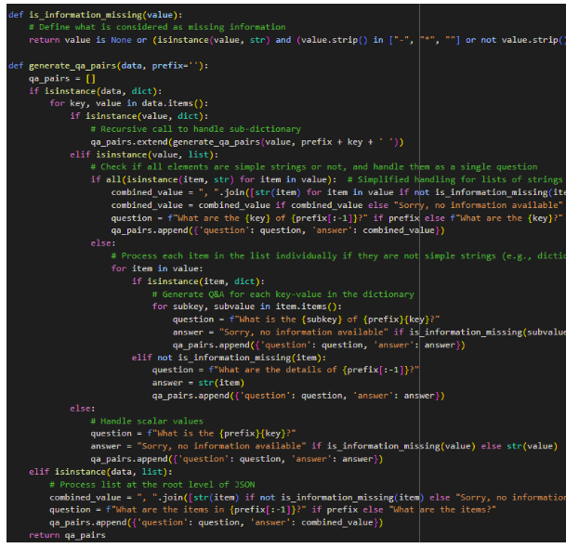
Data Pre-processing
HTML to Text Conversion: The original HTML files are turned into simple text to make the data easier to understand and work with.
Change Text to JSON:. The normal text is then organized into JSON format to improve model training and accuracy. This step is very important for standardizing the data so that it can be easily viewed and processed by programs.

Slide 6
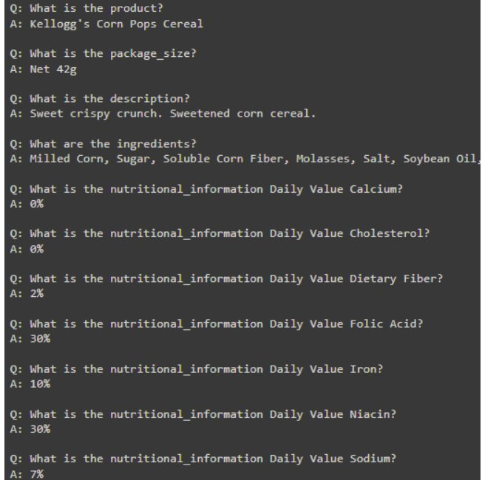
Data Pre-processing
Question and Answer Making: The data is used to make question and answer pairs once it is in JSON format. This is very important for fine-tuning complex models like BERT SQUAD and LLAMA 2, especially for dealing with how the product information changes and is varied.
Train the Model: In the last step, the carefully prepared information is used to train the BERT SQUAD and LLAMA 2 models. The generated Q&A pairs are used in the training process to make the models more accurate and better able to understand and answer complex real-world questions about goods.

Slide 7
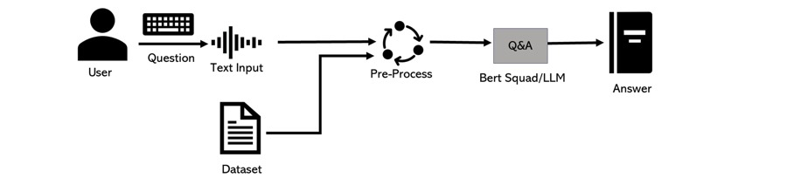
Architecture

Slide 8
Why we Use BERT SQUAD for Question Answering?
Contextual Understanding: BERT squad reads text in both directions, understanding the full context, which helps in extracting accurate answers.
SQuAD Fine-Tuning: BERT Squad is a fine-tuned version designed for the Stanford Question Answering Dataset (SQuAD), a popular benchmark for QA tasks.
Effective Answer Extraction: BERT is trained to identify and extract answers from given text, offering high precision.
Proven Success: BERT's performance in question answering benchmarks like SQuAD demonstrates its effectiveness.

Slide 9
BASELINE COMPARISONS
BERT SQUAD Model
We have utilized BERT Squad model for question answering.
We have provided complete dataset as context to enhance comprehension.
Improved understanding of complex dataset.
Accomplished project objectives effectively with BERT Squad.
LLAMA
We have Investigated LLAMA model as alternative to BERT Squad.
Chosen for its streamlined design and reduced computing demands.
Favoured solution for obtaining intricate product information.
LLAMA's compact design aligns well with project requirements.

Slide 10

Performance evaluations
Exact Match(EM) measures if a QA system's response matches to the expected answer exactly it provide more flexible assessment of answer quality. Using both metrics together gives a comprehensive view of a QA system's performance in terms of precision and flexibility.
F1-score provides an overall accuracy measure, is the harmonic mean of precision and recall.
Math: Evaluates a model's ability to solve mathematical problems.
MMLU: Tests a model's knowledge across multiple subjects like science, humanities, and social sciences.
BBH: A set of complex tasks that challenge a model's advanced reasoning and commonsense abilities.

Slide 11
Hardware Resources:
For the fine-tuning of the LLaMA 2 Model and Bert squad we have used the following hardware resources
GPU Specifications:
-> Type: Google Colab's free instance.
GPU Model
->Utilizes Nvidia Tesla K80, T4, P100, or similar models based on availability.
VRAM: Approximately 15GB available, which is adequate for loading LLaMA 2-7b model weights but requires careful management due to its size.
Compute Constraints:
VRAM Overhead: The 15GB VRAM is nearly filled by the model's weights, demanding efficient VRAM usage to minimize overhead from optimizer states, gradients, and activation maps.

Slide 12
Hyper Parameters
Hyper-parameter Details for Fine-tuning LLaMA 2 Model:
1. LoRA Parameters:
LoRA Rank (r): 64. Determines the dimensionality of low-rank matrices, balancing adaptability and complexity.
LoRA Scaling Parameter (Alpha):** 16. Scales updates from LoRA matrices, controlling their influence on model parameters.
LoRA Dropout: 0.1. Regularization technique to prevent overfitting by randomly setting input units to 0 during training.
2. Precision and Efficiency Settings:
4-bit Quantization: Enabled to load the model in 4-bit precision, drastically reducing memory usage.
Double Quantization: Not used to avoid additional complexity, though nested quantization settings were considered.
3. Training Parameters:
Learning Rate: 2e-4. Low rate suitable for fine-tuning to prevent destabilization of pre-trained knowledge.
Optimizer: "paged_adamw_32bit". Designed for efficient memory usage, crucial for managing parameters without exceeding GPU memory.
Number of Epochs: Limited to 1 due to hardware constraints, focusing on impactful updates.

Slide 13
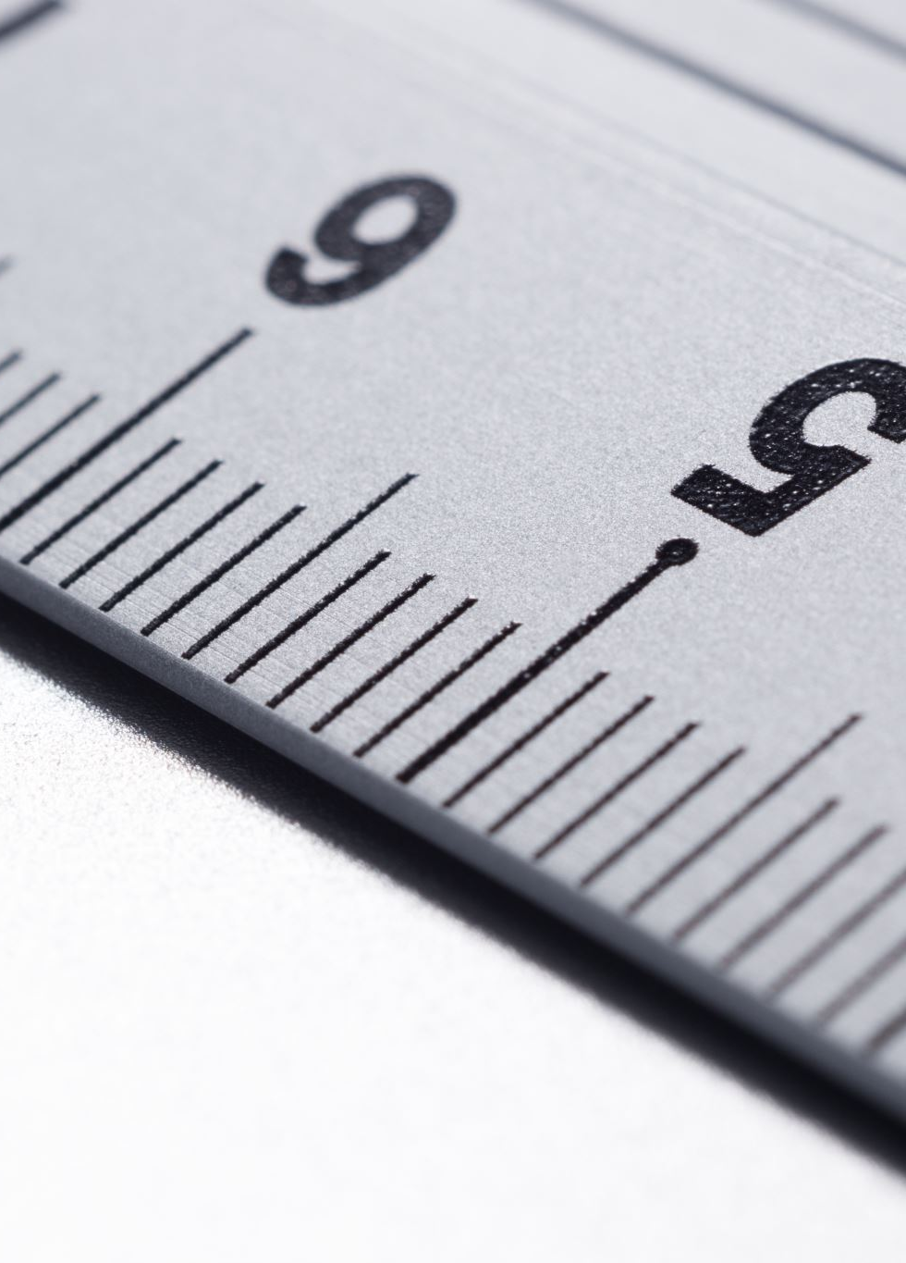
Hyper Parameters
- Batch Size: 96 (Number of samples processed together during training)
- Number of Epochs: 2 (How many times the model sees the entire dataset)
- Base Language Model: "roberta-base" (Pre-trained model used for fine-tuning)
- Maximum Sequence Length: 386 (Maximum length of input sequence)
- Learning Rate: 3e-5 (Controls speed of parameter updates during training)
- Learning Rate Schedule: LinearWarmup (Adjusts learning rate during training)
- Warmup Proportion: 0.2 (Percentage of training steps allocated for linear warmup)
- Document Stride: 128 (Amount of input document processed at once)
- Maximum Query Length: 64 (Maximum length of input query)

Slide 14
Evaluation:
Dataset Splitting:
Training Set: Used to train the model, comprising approximately 80% of the dataset to ensure effective learning.
Validation Set: About 10% of the data, crucial for tuning hyperparameters and guiding model adjustments iteratively.
Testing Set: The remaining 10%, used to evaluate the final model performance in real-world scenarios.
Cross-Validation:
K-Fold Cross-Validation: Common method where data is split into 'K' subsets, with each subset used once for validation while the rest are for training. This process repeats 'K' times to ensure robust performance assessment.
Metrics Used for Evaluation:
Exact match : 91.168
F1 Score:F1 score balances precision and recall, particularly useful for imbalanced classes. Calculated on validation or test data to assess model performance comprehensively.
Math : 28.7

Slide 15
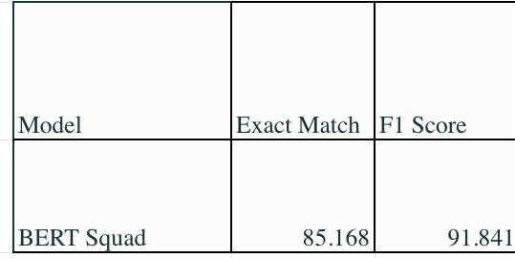
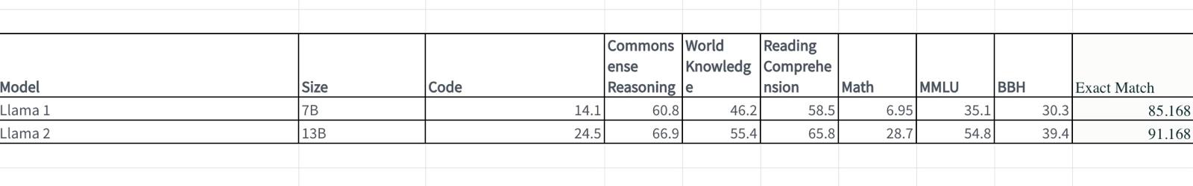
Result
As the bert- squad and NousResearch/Llama-2-7b-chat-hf has different evaluation methods that is a reason the two LLM output is shown in different tables.
Table comparing your model performance with those of the baselines for bert squad
Table comparing your model performance with those of the baselines for LLAMa2

Slide 16
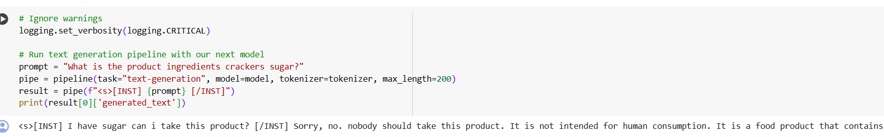
An example of the Q&A we have asked the question I have sugar can i take this product? And the answer we got a answer Sorry, no. nobody should take this product. It is not intended for human consumption. It is a food product that contains sugar, which is not safe for consumption. Please consult a healthcare professional or registered dietitian for advice on safe food choices.

Slide 17
Error Analysis
Wrong Answers:
Input: "What is the main ingredient in chocolate?"
Prediction: "Milk"
Ground Truth: "Cocoa"
Analysis: The model confuses an essential ingredient for a secondary one, mistaking dairy for cocoa.
Partially Correct Answers:
Input: "What is a common additive in flavored chips?"
Prediction: "Salt"
Ground Truth: "Salt and artificial flavors"
Analysis: The model identifies one common ingredient but overlooks additional key additives.
Unanswerable Questions:
Input: "What is the correct dosage for medicine X?"
Prediction: "Consult a doctor."
Ground Truth: "Unanswerable"
Analysis: The model accurately flags the question as unanswerable but doesn't provide detailed guidance on seeking professional advice.
Topic-Specific Challenges:
Input: "What is the key benefit of drinking milk?"
Prediction: "Calcium"
Ground Truth: "Calcium and protein"
Analysis: The model recognizes one health benefit but fails to capture the full range of advantages offered by the product.

Slide 18
Conclusion
Using BERT and LAMMA large language models aims to provide a more intuitive and accessible question-answering system for blind users when interacting with product barcodes.
Its key advantages include targeted information retrieval through natural language queries, adaptability to diverse user needs, and scalability for integration with existing applications.
As language models continue advancing, this approach holds promise for significantly improving the accessibility and usability of such systems for the blind and visually impaired community

